Slide 1
NEAR Analytics
Balázs Várady

Slide 2
Motivation
Common data analysis problems:
Data manipulation
Certain resources required
By deploying to NEAR:
No censorship
Transparent analysis and handling
Resources are available
Resources are limited
May be expensive

Slide 3
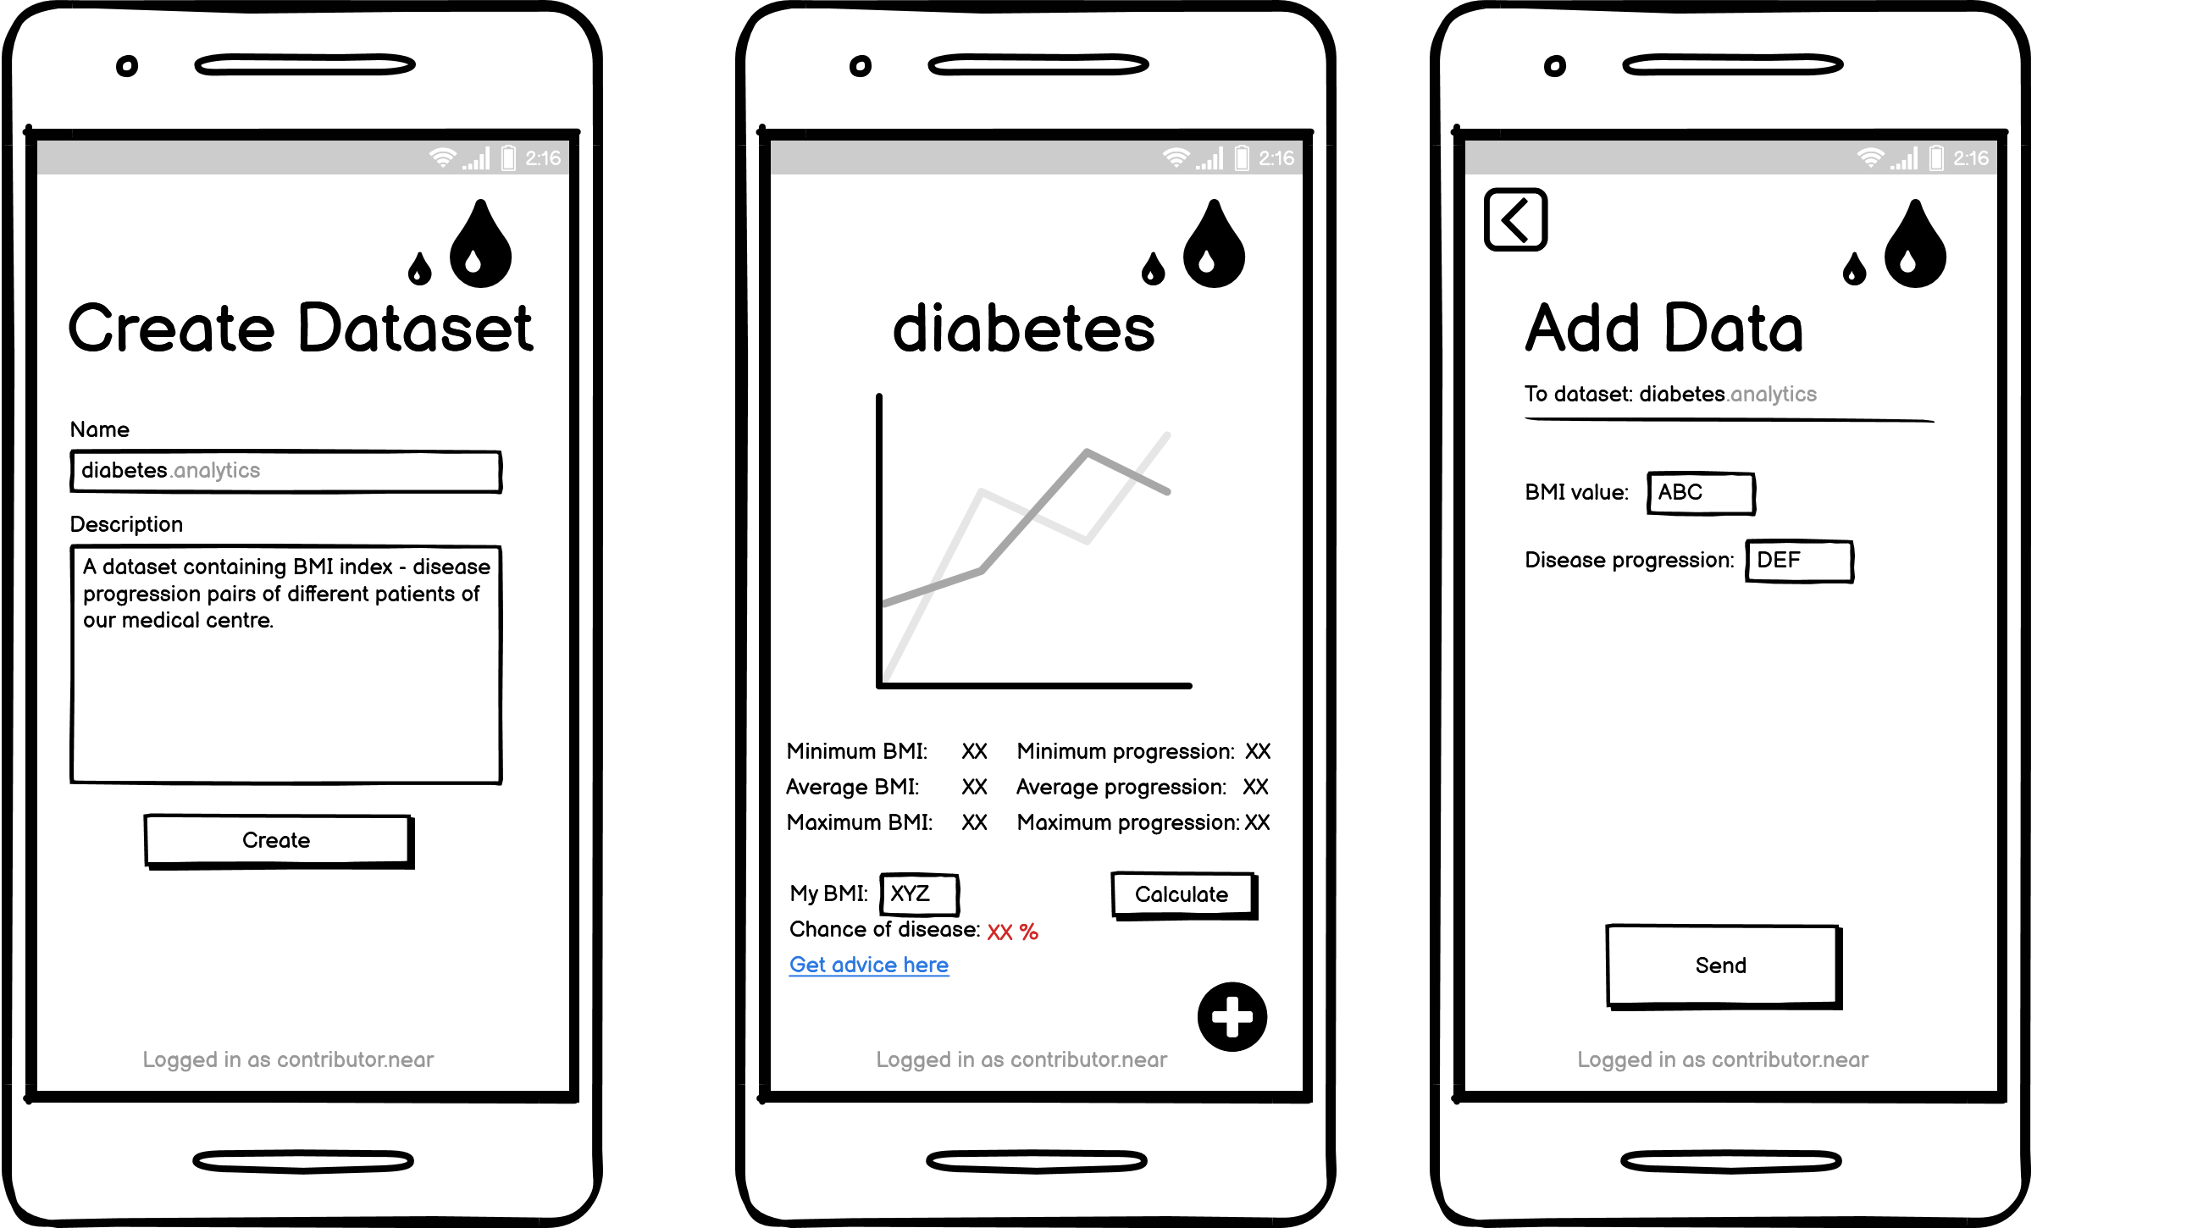
Example

Slide 4
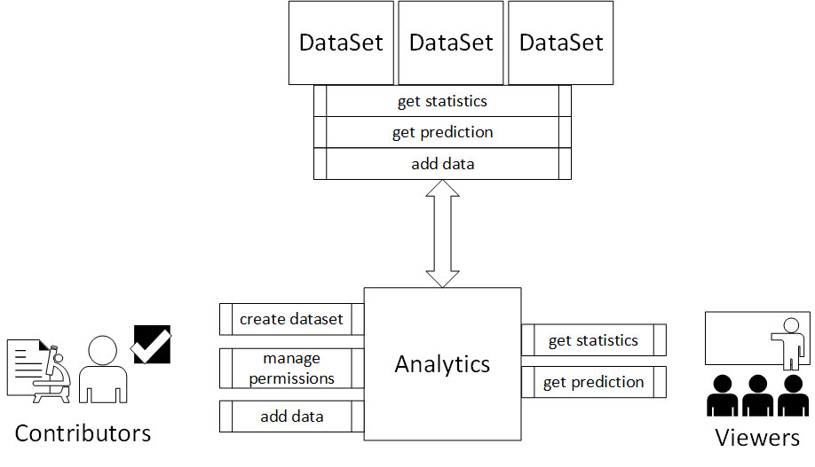
Concept

Slide 5
Code Demo

